Slide 1



Suggested Solutions of Sharif Internet Contest 2010
Shayan Ehsani
Saeed Seddighin

Slide 2
Problem A: Compression!
5761 19 10 1
So Simple! Do the first thing that comes to your mind!

Slide 3
Problem A: Compression!
cin >> n;
while (n>9){
int temp=0;
while(n>0){
temp+=n%10;
n/=10;
}
n=temp;
}
cout << n << endl;

Slide 4
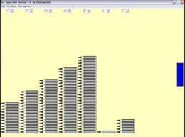
Problem B: Nimper
Nim is a Chinese game.
Nimm in German means “Take”.
Idea: XOR!

Slide 5
Problem B: Nimper
Task : Given a set of numbers, you have to remove minimal sum of numbers to obtain a ‘Lose-state’ free set. A Lose-state is a subset which the binary-exclusive-or of its numbers is equal to zero.
Method : Greedy !!!
Solution :
Do the following steps as long as your set contains a Loose-state :
  1- Find a loose state.
  2- Remove its minimum number from set.

Slide 6

Problem C: Jangalestan
Task: Find the number of connected components in a grid.
Solution: Any search method on the graphs! DFS,BFS,…

Slide 7
Problem C: Jangalestan
Trick:
int move[8][2]={{0,1},{0,-1},
{1,0},{-1,0},
{1,-1},{1,1},
{-1,1},{-1,-1}};

Slide 8
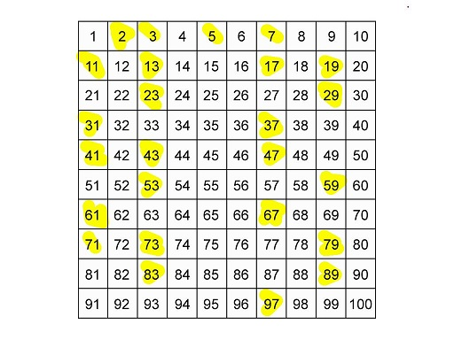
Problem D: Prime Numbers…Again

Slide 9
Problem D: Prime Numbers…Again
How to find prime numbers?
vector<int> make_prime(int max) {
Not_Prime[2]=false; vector<int> Primes;
Primes.clear();
for(int i=2;i<=max;i++){
if (Not_Prime[i]==false){
Primes.push_back(i);
for(int j=2*i;j<=maxn;j+=i)
Not_Prime[j]=true;
}
}
return Primes;
}

Slide 10

Problem E: Word Maker
Task: You are given a set of polyhedrons and words. Determine how many of the words can be made by juxtaposing these polyhedrons ?

Slide 11
Problem E: Word Maker
Idea: Maximum Matching!
{a,b,t} {x,y,y} {x,a,b}
a b x

Slide 12
Problem E: Word Maker
Idea: Maximum Matching!
{a,b,t} {x,y,y} {x,a,b}
a b x

Slide 13
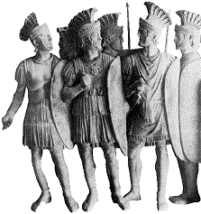
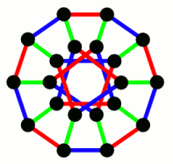
Problem F: Weird Coloring
Task: Find the minimum Edge Roman Domination Function

Slide 14
Problem F: Weird Coloring
Idea: This problem is NP-Hard, So the solution is: Branch & Bound!
Branches: First assign 2 to the most effective edges.
Bounds: There are never two adjacent edge uv and vw such that α(uv)>0 and α(vw)>0.

Slide 15
Problem G :Trundling Object
Class : Graph algorithms
Idea : BFS (breadth first search) or DFS (depth first search)
Solution :
  Consider the following graph:
  Each vertex of graph is mapped to a possible situation of cube.
  How many vertices? At most 3 X N X M.
  Why?
  - 3 possible ways to rotate the cube
  - N X M possible ways to put the cube on the table
  If we can trundle the cube in order to move from one state to the other, we draw an edge between pertinent vertices of the graph.
  How many edges? At most 9 X N X M
  Why?
  Degree of each vertex is at most 6 so there are at most 6 X 3 X N X M / 2 edges in the graph.

Slide 16
Problem G :Trundling Object
  Some vertices of the graph are blocked (Which ones?)
  Find all vertices that are reachable from the vertex mapped to the initial situation .
  How? BFS or DFS
  Now What?
  Which cells of table have ability to become black?

Slide 17
Problem H: Remainder Calculator
viewer discretion is advised

Slide 18
Problem H: Remainder Calculator
How to calculate a! Mod m?
  Simple:
    If (a > m) return(0);
    Otherwise:
    u=1
    for (int i=1;i<=a;i++)
      u=u*i Mod m;

Slide 19
Problem H: Remainder Calculator
First Step: Let simplify the problem: Assume that we want to calculate a!^v mod m. Firstly, calculate u=a! mod m. So, we want to calculate u^v mod m. Notice, that value of u^{i} mod m will be in range [0, m - 1] for any non-negative integer i. Imagine we are iterating i starting from 0. We'll receive following values: u⁰ mod m, u¹ mod m, and so on. According to the pigeonhole principle, one of the values will repeat in no more than (m + 1) iterations. Consider the following example. Let u = 2, m = 56. The first 7 iterations are shown in the table:

Slide 20
Problem H: Remainder Calculator
i | 0 | 1 | 2 | 3 | 4 | 5 | 6
u^i mod m | 1 | 2 | 4 | 8 | 16 | 32 | 8
Let P=Size of precycle and L=Size of cycle. For any v to calculate u^v mod m, we should see the column:
i= P + ( L + v mod L - P mod L ) mod L
Of our table. Thus, our problem will reduce to calculating v mod L.

Slide 21
Problem H: Remainder Calculator
Consider a_1!^a_2!^…^a_n! as v
The task is to find a_0! ^ v Mod m:
  We can compute a_0! as mentioned so the task is reduced to computation of p^v Mod m.
  It is known that for every p and m there exist two numbers T and L satisfying the following condition:
    If v_1 and v_2 are two numbers greater than p and v_1 Mod L = v_2 Mod l then p^v_1 Mod m = p^v_2 Mod m.

Slide 22
Problem H: Remainder Calculator
So after finding value of p , L and T:
if (a_2!^a_3^…^a_n Is less than T)
compute p^(a_2!^a_3^…^a_n) Mod m
otherwise
solve a_2!^a_3^…^a_n Mod L and compute p^(a_2!^a_3^…^a_n Mod L) Mod m.

Slide 23
Problem I: Number Convertor
Task: Find the minimum cost way to convert a to b with given numbers.
Idea: Shortest Path Algorithms
Solution
  Put a vertex for each number between 0 and 10⁵
  For each two numbers x and y if x can be convert to y with one operation, then put a direct edge from x to y with weight of the cost of operation.
  Now, find the shortest path between a and b

Slide 24


